Slide 1

Trip Finder
Team Member :
ندي منصور سمير
شهد السيد عبد المنعم
مؤمن محمد رمضان
مريم نعيم سناده
Responsible training company: AST
Group Code: Mobile App Developer_CAI1_SWD4_S8e

Slide 2
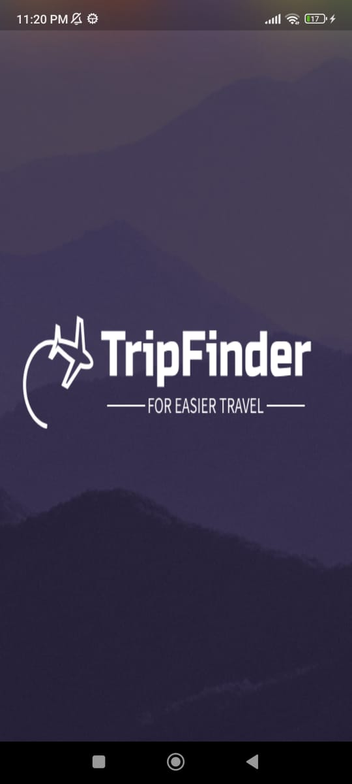
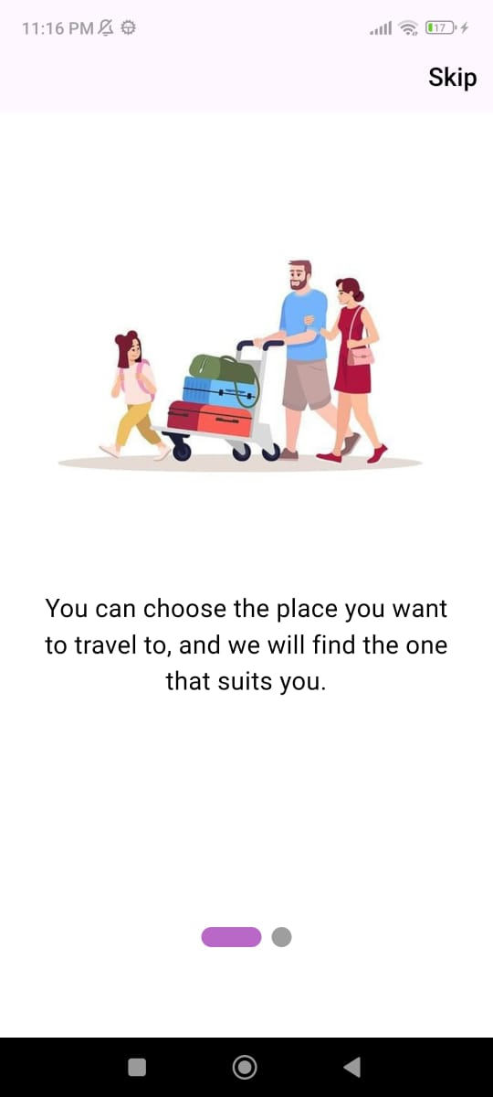
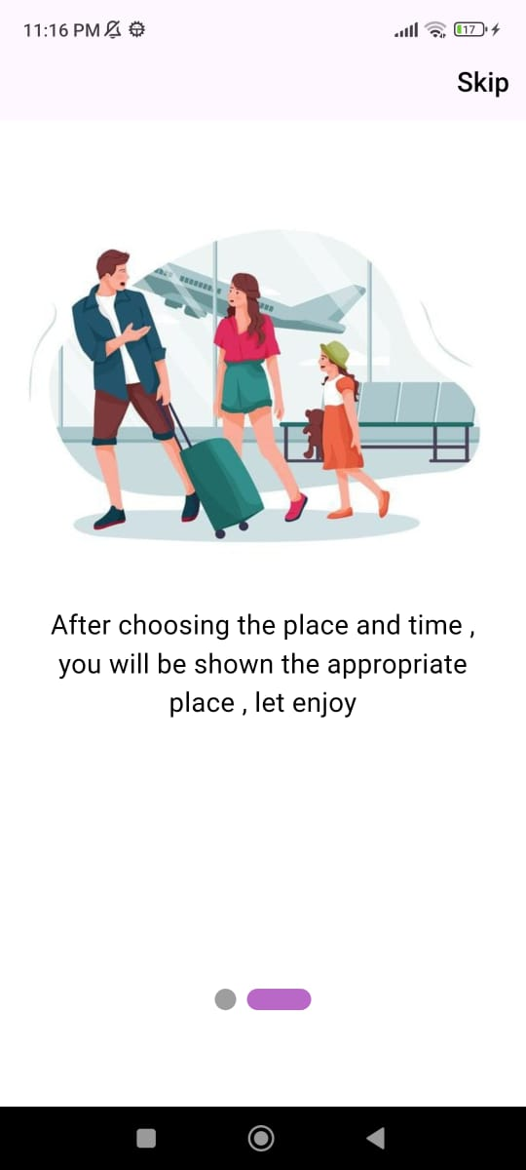
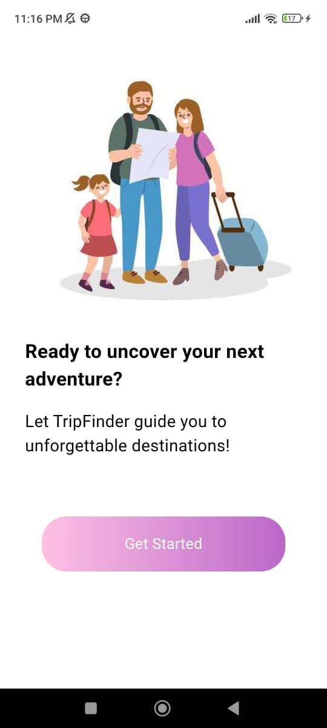
Splash screen and introduction to the application
Trip Finder

Slide 3
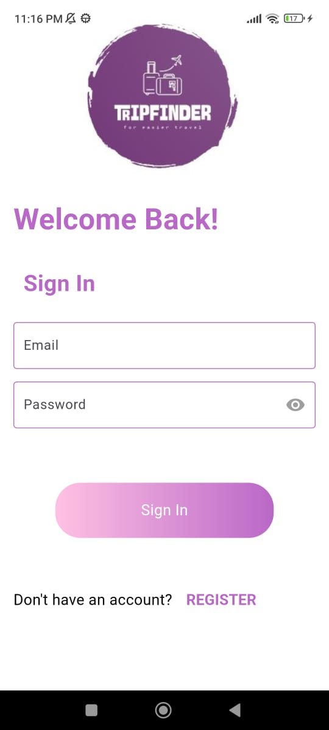
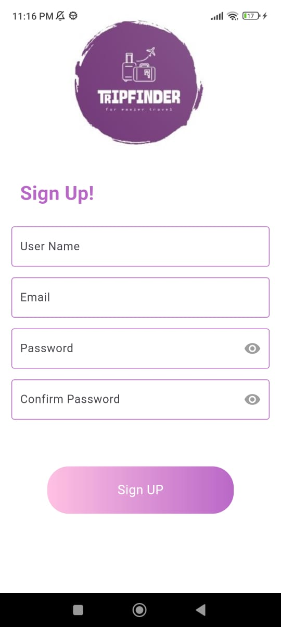
Login and Signup using Firebase Technology
Trip Finder

Slide 4
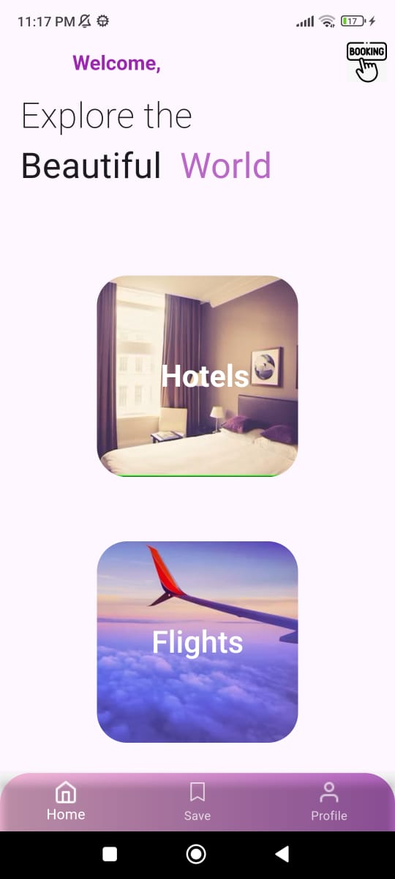
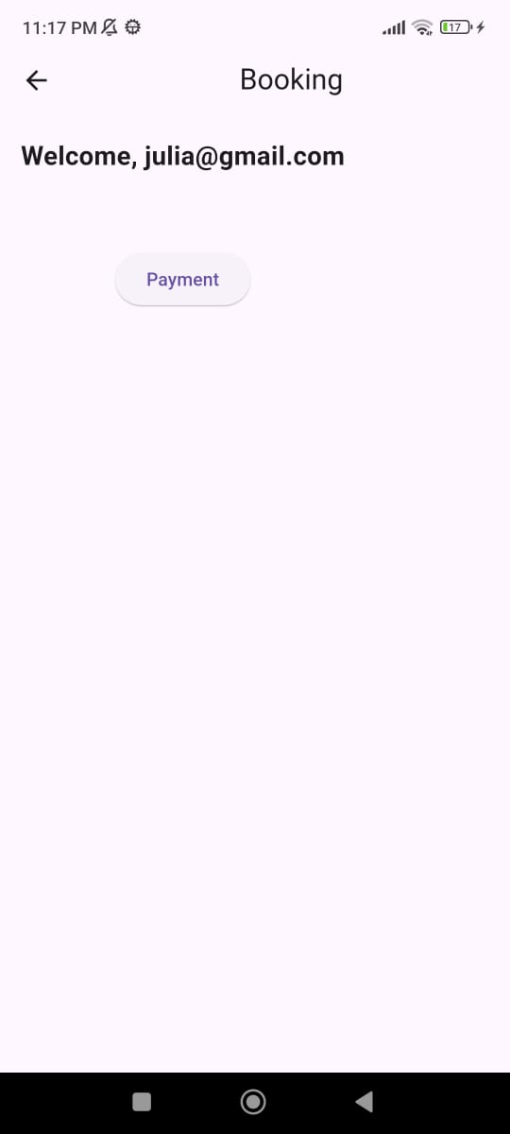
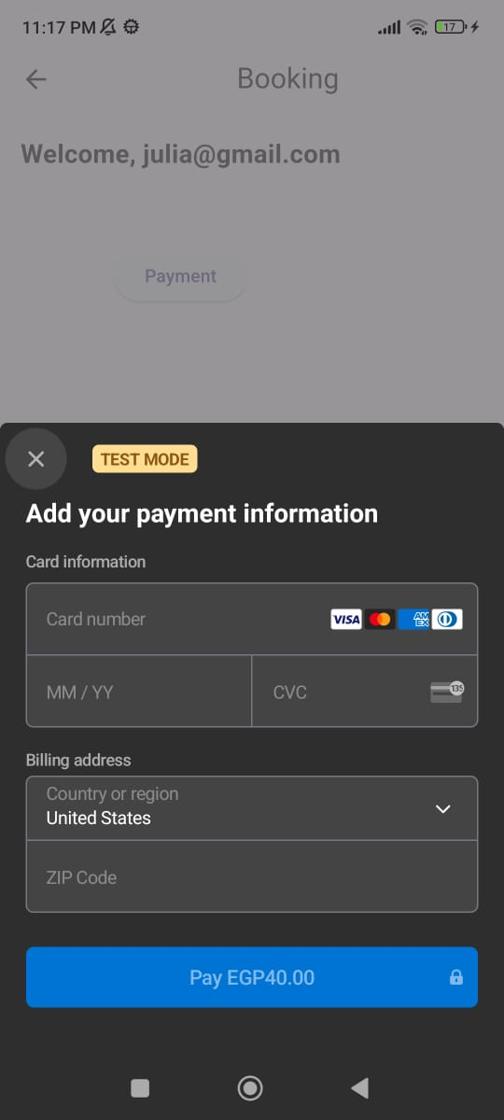
Home Screen User has two Category (Hotel, Flight)and the Booking page using payment Method to book what user wants
Trip Finder

Slide 5
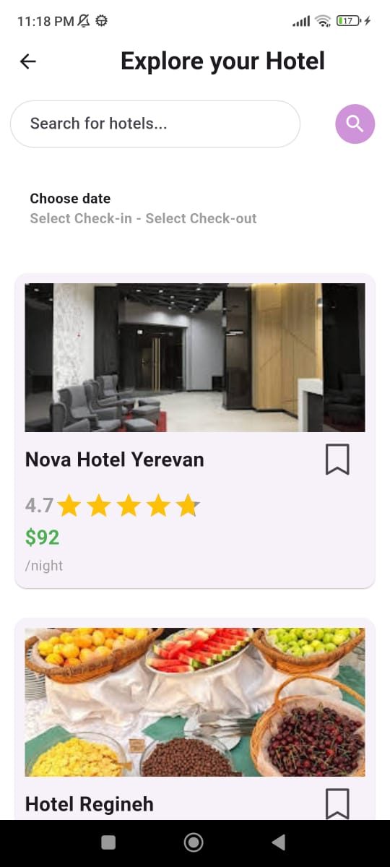
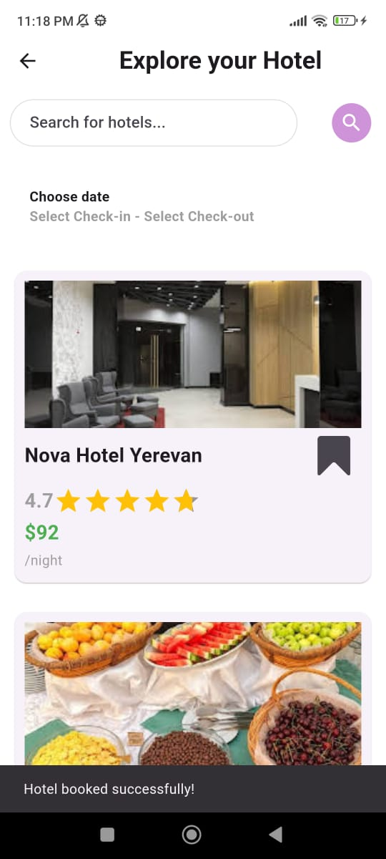
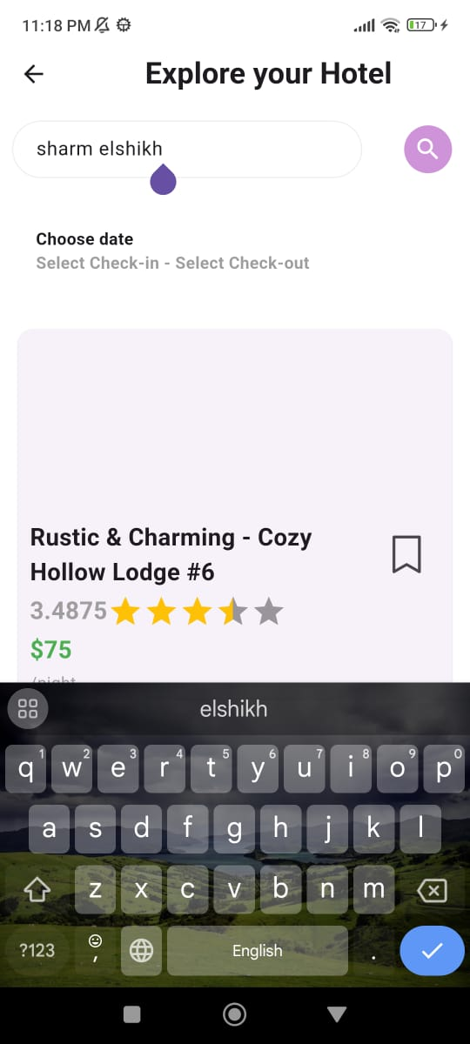
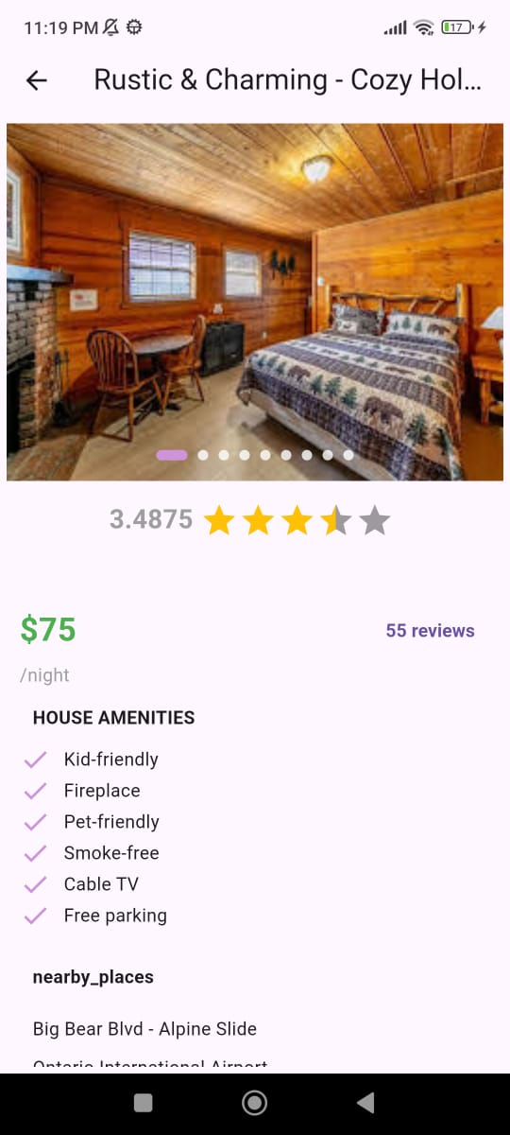
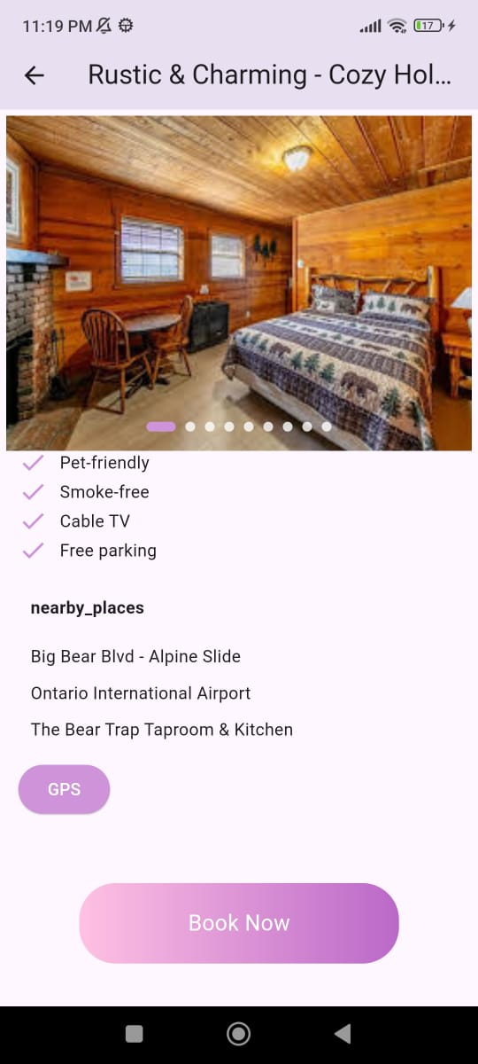
When the user selects the "Hotels" category, they will be taken to the hotels page, where they can search for hotels in various countries. The application will display the best hotels along with their prices and ratings. Users will also have the option to book a hotel or save it for later.
Using API , Firestore and Firebase Technology
Trip Finder

Slide 6
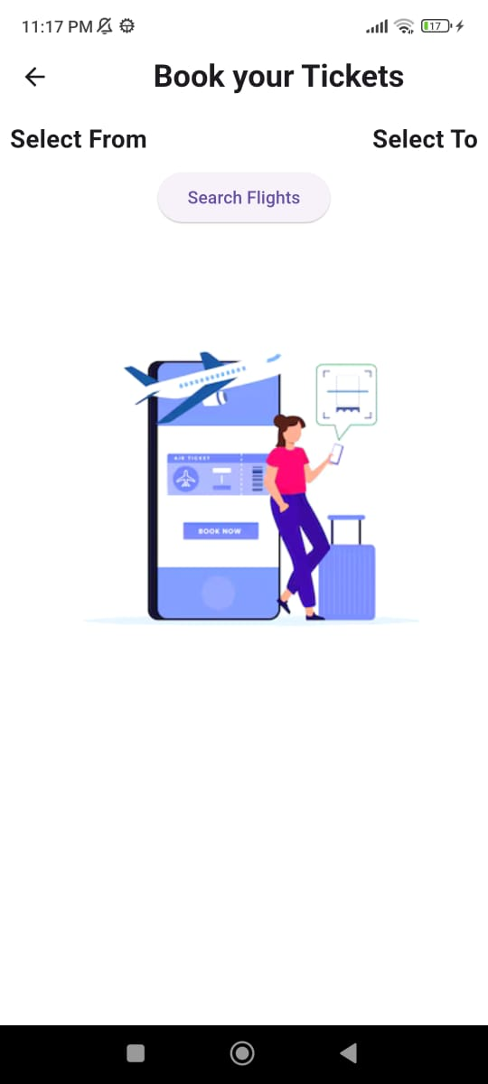

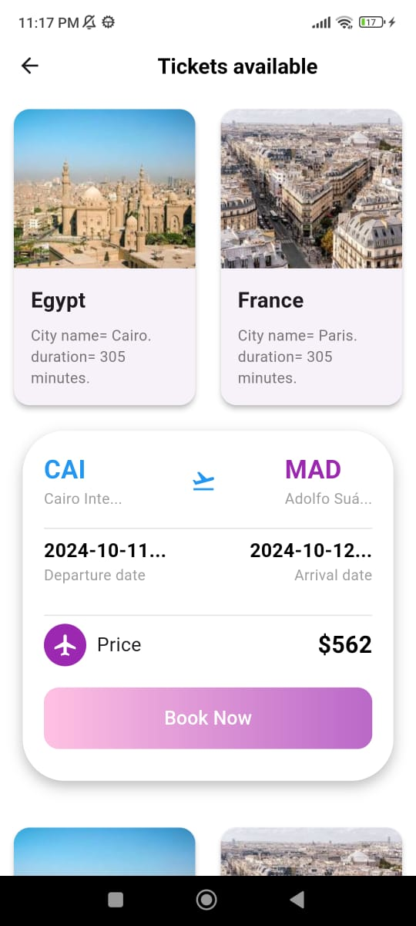
When the user selects the "Flights" category, they will be taken to the Flights page, where they can enter their departure country and the destination country. The application will display all available flights along with their prices, and the user will have the option to book a flight. This functionality will utilize API, Firestore, and Firebase technologies.
Trip Finder

Slide 7
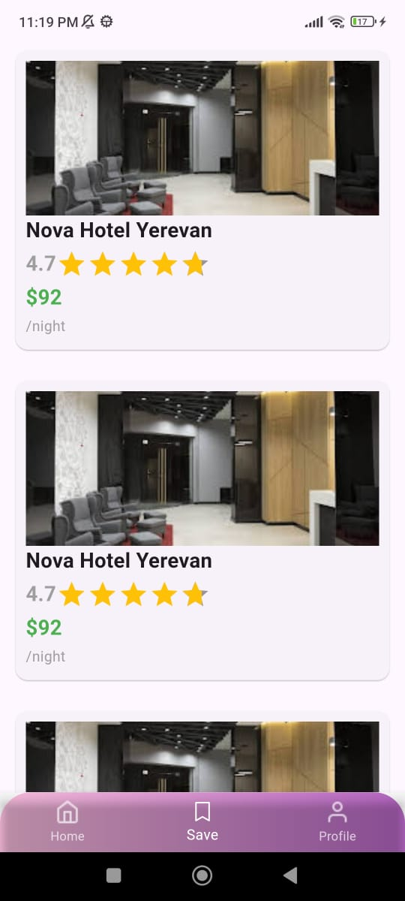
When User Save the hotel and go to save page
(Using Firestore technology)
Trip Finder

Slide 8
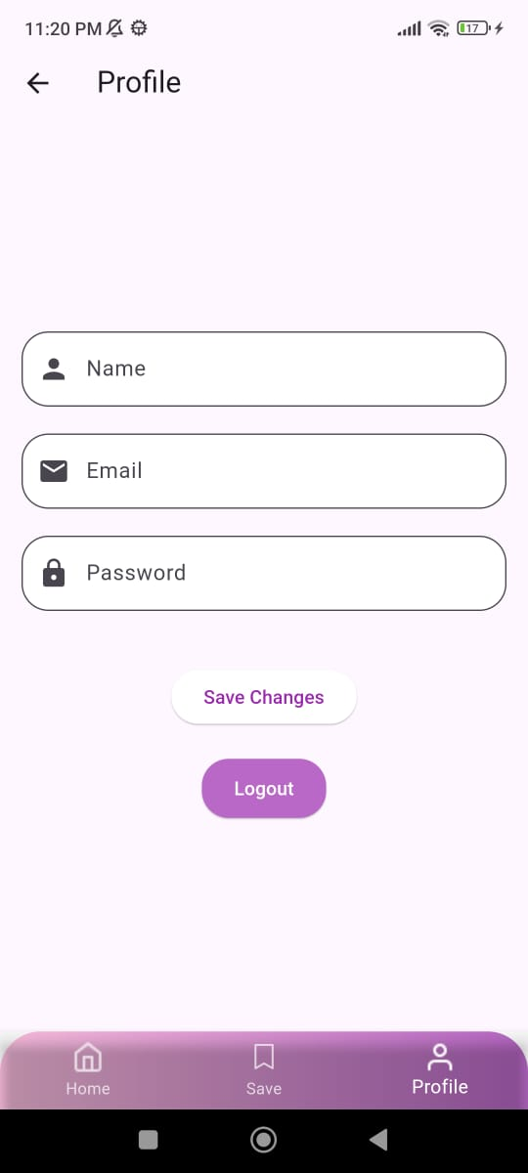
When user go to Profile Page can edit his details like username, email, password and can to logout Using Firebase Technology
Trip Finder

Slide 9
Thank You
Trip Finder
Nada Mansour
Shahd Waly
Momen Mohamed
Mariem Naeem

